Slide 1
GOOD DISPENSING PRACTICE
2 JULAI 2022 (SABTU)
SITI FIRAS BINTI AHMAD RAZEF
Notes:
1

Slide 2
Message from The Director General of Health Malaysia
“Patients and their families give great emphasis to the issue of safety when seek healthcare. They come to us to get better and rightly expect that they will not be harmed by the treatment we give to them”
Ybhg, Tan Sri Dato’ Seri Dr. Noor Hisham bin Abdullah
Director General of Health
1st National Patient Safety Campaign
Putrajaya 24th June 2013

Slide 3
INTRODUCTION
Patient safety is a priority
Important to prevent medication error
Medication error may happen during – Prescribing, transcribing, dispensing or administering process. Hence it is essential to ensure each process is done correctly

Slide 4
INTRODUCTION
Is prescription error common?
Statistics from MOH showed that total number of reported ME has increased from 2818 to 3046 cases in 2019. The statistics include actual error and near miss (Source: e-IP 2018-2019, Patient Safety Unit, MOH)
Amongst the various types of ME, prescription error showed the highest number of cases (2878 – 51%) followed by dispensing error (1036 – 18%).
Fortunately, majority of the prescription error managed to be detected and only 528/2878 (18.3%) has led to actual ME.

Slide 5
Dispensing
Dispensing refers to the process of preparing and supplying medicines to a named person together with clear instructions, advice and counselling where necessary on the use of those medicines
Interpret correct order
Accurate preparation and labelling

Slide 6
Good Dispensing Practice
Ensures right medicines of desired quality are delivered correctly to the right patient
Dispensing Environment
Stock arrangement
Be clean, get organized! Give the Pharmacy a professional look
Dispensing Process
Notes:
Be clean – professional impression and outlook to the pharmacy
Be organized – To provide for a safe and efficient working area

Slide 7
Manual prescription vs E-prescription?

Slide 8
Dispensing Process
Processing the prescription

Slide 9
Processing the prescription
1) Screening
On receiving a prescription, it should be screened and validated to ensure that it is for the correct patient and it complies with the requirements in the Poisons Act.
The prescription should have the following information:
Patient Details | Prescription Details
Name RN Identification number (IC/ Passport No) Age and body weight* | Drug regimen (name of medicine, dose, frequency, administration and duration) Doctor’s signature, stamp and registration number Doctor’s name and address Date of prescribing
* For children under 12 years of age and selected medications

Slide 10
Processing the prescription
2) Interpreting the Prescription Order
The person receiving the prescription should check for:
Dose, frequency and duration
Drug interactions, medicine duplication, polypharmacy, inappropriate drug therapy, contra-indications.
Allergies
Unusual usage and suspected drug misuse or abuse.
For partial medicine supply, ensure that the second or subsequent supply does not exceed the quantity for the duration prescribed.

Slide 11
Processing the prescription
3) Handling Prescriptions which Require Clarification
Incomplete prescription – Missing details
Further clarification is needed – dose, frequency, strength, polypharmacy (different clinic)
Attempts must always be made to contact the prescriber:
Authorisation by phone call to make any changes
If the prescriber cannot be contacted, patient should be informed and the prescription must be sent back to the prescriber with information on the clarification/action needed.
Prescriber should document any changes made to the patient’s medical record.

Slide 12
Processing the prescription
Preparing the Medicines

Slide 13
Preparing the Medicines
Filling
Selecting Medicines - Medicine name, Strength, Expiry
Extemporaneous Preparation/ Compounding - Based on reputable references*
Compounding worksheet – counter-checked by another staff member
Formula
Ingredients and quantity used
Manufacturer, batch number and expiry date of ingredients used
Patient & prescription details
Names of person involved in preparing and counterchecking the product
Date of compounding
Label – expiry date, batch number
Notes:
Appendix 1: Suggested References for Extemporaneous Preparation/Compounding a) Allen L.V, Jr. Suppositories, 1st Edition. 2007 b) Allen L.V, Jr. The Art, Science, and Technology of Pharmaceutical Compounding c) Alberta Health Services. Pharmacy Compounding Manual. 2011 d) British Pharmacopoeia e) Extemporaneous Formulation, Pharmaceutical Services Division, Ministry of Health f) Jew RK, Soo-Hoo W, Erush SC. Extemporaneous Formulations for Pediatric, Geriatric, and Special Needs Patients, 2nd Edition.2010 g) International Journal of Pharmaceutical Compounding and other established journals h) Martindale: The Complete Drug Reference i) Nahata MC, Pai VB. Pediatric Drug Formulations, 6th Edition.2011 j) Calgary Health Region Pharmacy. Pharmacy Compounding Manual. 2008. k) Rowe, Raymond C, Sheskey, Paul J, Cook, Walter G, Fenton, Marian E. Handbook of Pharmaceutical Excipients, 7th Edition. 2012 l) Sarfaraz K. Niazi. Handbook of Pharmaceutical Manufacturing Formulations (Vol. 1-6). 2004 m) Trissel LA. Trissel's™ Stability of Compounded Formulations 5 th Edition n) Rockville, MD: The United Stated Pharmacopeia Convention. USP Pharmacists’ Pharmacopeia Second Edition. 2008-2009

Slide 14
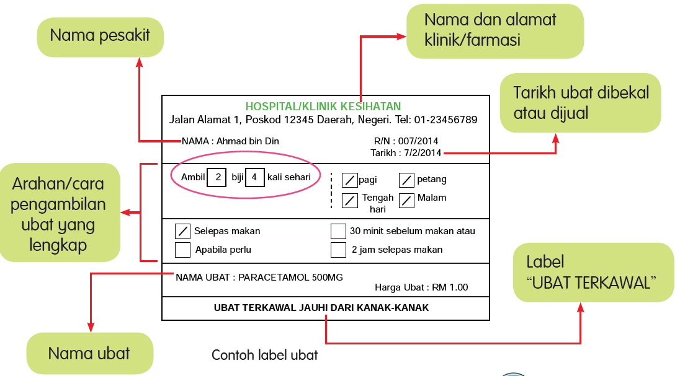
Preparing the Medicines
Labelling
Notes:
Ubat-ubatan boleh dikategorikan dalam 2 jenis, iaitu Ubat Terkawal dan ubat am. Ubat Terkawal merupakan ubat yang hanya boleh diperolehi dengan preskripsi doktor (sebagai contoh, ubat darah tinggi atau ubat
kencing manis), manakala ubat am merupakan ubat yang boleh dibeli tanpa preskripsi doktor (sebagai contoh, ubat suplemen kesihatan atau vitamin).
Pengkelasan ini boleh dikenalpasti berpandukan abjad yang digunakan pada hujung nombor pendaftaran ubat. Abjad A digunakan untuk merujuk kepada ubat terkawal manakala abjad T dan X digunakan bagi ubat am.

Slide 15
Processing the prescription
Preparing the Medicines
Counter-Checking

Slide 16
Counter-checking
Other than filling staff
Triangular checking
Record if needed

Slide 17
Processing the prescription
Preparing the Medicines
Counter-Checking
Dispensing

Slide 18
Dispensing
Ensure 5R
Check name and RN/ID
Allergies
Proper storage condition
Compliance aids (syringe)
Advise for any ADR encounter

Slide 20
Maintaining Pharmaceutical Stocks
Stored in original container unless pre-packing.
Name of medicine
Dosage form (mg, mg/ml, mg/g)
Manufacturer batch number
Manufacturer expiry date
Internal/ external should store separately
stability of drug and manufacturer recommendation
DDA & Psychotropic substances stored in locked cabinet
LASA and expiry date

Slide 21
Delivery of Repeat Medicines by Post
First time supply must always be dispensed at the pharmacy counter.
Delivery service should ONLY be provided for prescription that is partially-supplied.
Criteria for eligibility:
Stable and compliant patients
Partial supply medicines for chronic diseases
Cold chain item?
DD & Psychotropic drugs should not be delivered by post.
Agreement from the patient must be obtained prior to providing the delivery service and appropriate records of requests for the service must be kept.

Slide 22
www.kahoot.it

Slide 24
THANK YOU
As of June 2019
Notes:
24

