Slide 1
Summary nham 2022 title: syncope: what can I do in primary care
PRESENTATION BY: DR HARTINI MOHD YUSOF
CARDIOLOGIST, HOSPITAL SERDANG
SUMMARY BY: DR NURHAYATI BINTI MOHD SOBKI
PUSAT KESIHATAN UNIVERSITI, UPM

Slide 2
definition
SYNCOPE IS DEFINED AS TRANSIENT LOSS OF CONSCIOUSNESS (TLOC), DUE TO CEREBRAL HYPOPERFUSION, CHARACTERIZED BY:
RAPID ONSET
SHORT DURATION
SPONTANEOUS COMPLETE RECOVERY

Slide 3
aetiology
NEURALLY MEDIATED
VASOVAGAL (SIMPLE FAINT)
SITUATIONAL-COUGH, MIXTURATION, SWALLOW
CAROTID SINUS HYPERSENSITIVITY
ORTHOSTATIC
MEDICATION-INDUCED
VOLUME DEPLETION
SECONDARY AUTONOMIC FAILURE –PARKINSON’S DISEASE
PRIMARY AUTONOMIC FAILURE
ENDOCRINE PROBLEM-ADDISON’S DISEASE
CARDIAC ARRHYTHMIAS
BRADYCARDIA- SINUS NODE DYSFUNCTION
TACHYCARDIA-SUPRAVENTRICULAR & VENTRICULAR
STRUCTURAL
STRUCTURAL CARDIAC-AORTIC STENOSIS, ACUTE MYOCARDIAL INFARCTION, CARDIAC MASSES
CARDIOPULMONARY AND GREAT VESSELS

Slide 4
Diagnostic work up
HISTORY
PHYSICAL EXAMINATION INCLUDING ORTHOSTATIC: STANDING BP/HR IMMEDIATE, 1 AND 3 MINUTES OR LONGER (FOR COVERT ORTHOSTATIC HYPOTENSION)
ECG
ECHOCARDIOGRAM +/- STRESS TEST
LABORATORY BLOOD INVESTIGATION
CARDIOLOGY REFERRAL-FOR FURTHER EVALUATION
LONG HOLTER MONITORING
TILT TABLE TEST
EXTERNAL/ IMPLANTABLE LOOP RECORDER
CONTINUOUS ECG PATCHES
SMARTPHONE ECG DEVICE

Slide 5
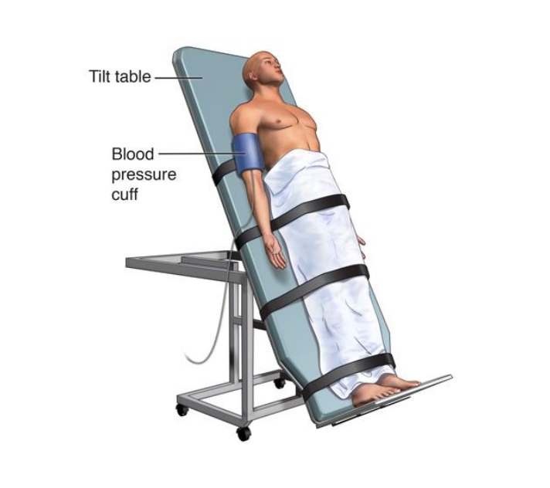
ADDITIONAL INVESTIGATION
CAROTID SINUS MASSAGE (CSM)
STIMULATION OF CAROTID SINUS TRIGGERS BARORECEPTOR REFLEX AND INCREASE VAGAL TONE, AFFECTING SINUS MODE AND AV NODE
CSS- A VENTRICULAR PAUSE LASTING >3 SEC AND/OR A FALL IN SYSTOLIC BP OF >50mmHG
CSS IS CONFIRMED IF CSM CAUSES BRADYCARDIA (ASYSTOLE) AND/OR HYPOTENSION THET REPRODUCE SPONTANEOUS SYMPTOMS, AND PATIENTS HAVE CLINICAL FEATURES COMPATIBLE WITH A REFLEX MECHANISM OF SYNCOPE
TILT TABLE TEST
INDICATIONS- TO CONFIRM A DIAGNOSIS OF REFLEX SYNCOPE IN PATIENTS IN WHOM THIS DIAGNOSIS WAS SUSPECTED, BUT NOT CONFIRMED BY INITIAL EVALUATION.
ASSESSMENT OF AUTONOMIC FAILURE, ESPECIALLY FOR THE REPRODUCTION OF DELAYED ORTHOSTHATIC HYPOTENSION

Slide 6
Risk stratification
SYNCOPAL EVENT
LOW RISK
ASSOCIATED WITH PRODROME TYPICAL OF REFLEX SYNCOPE (SWEATING, NAUSEA, LIGHT-HEADADEDNESS)
AFTER SUDDEN UNEXPECTED UNPLEASANT SIGHT, SOUND, SMELL OR PAIN
AFTER PROLONGED STANDING OR CROWDED, HOT PLACES
DURING A MEAL OR POSTPRANDIAL
TRIGGERED BY COUGH, DEFAECATION OR MICTURATION
WITH HEAD ROTATION OR PRESSURE ON CAROTID SINUS
STANDING FROM SUPINE/SITTING POSITION
HIGH RISK
MAJOR
NEW ONSET OF CHEST DISCOMFORT, BREATHLESSNESS, ABDOMINAL PAIN OR HEADACHE
SYNCOPE DURING EXERTION OR WHEN SUPINE
SUDDEN ONSET PALPITATION IMMEDIATELY FOLLOWED BY SYNCOPE
MINOR
NO WARNING SYMPTOM OR SHORT (< 10 S) PRODOME
FAMILY HISTORY OF SCD AT YOUNGE AGE
SYNCOPE IN SITTING POSITION

Slide 7
management
TREATMENT OF SYNCOPE (DIAGNOSTIC EVALUATION)
REFLEX AND ORTHOSTATIC INTOLERANCE
UNPREDICTABLE OR HIGH-FREQUENCY→ CONSIDER SPESIFIC THERAPY OR DELAYED TREATMENT (GUIDED BY ECG DOCUMENTATION)
PREDICTABLE OR LOW-FREQUENCY→ EDUCATION, REASSURANCE AVOIDANCE OF TRIGGERS
CARDIAC
CARDIAC ARRHYTHMIAS→ SPECIFIC THERAPY OF THE CULPRIT ARRHYTHMIA
STRUCTURAL (CARDIAC OR CARDIOPULMONARY) → TREATMENT OF UNDERLYING DISEASE
UNEXPLAINED AND HIGH-RISK OF SCD
CAD,DCM,HCM, ARVC, LQTS, BRUGADA SYNDROME→ CONSIDER RISK/BENEFIT OF ICD THERAPY

Slide 8
WHEN TO REFER CARDIOLOGY
MALIGNANT FEATURES OF THE SYNCOPE
ABNORMAL ECG/MURMURS/
ABNORMAL HOLTER
SUSPECTED/CONFIRMED VASOVAGAL BUT RECURRENT
CARDIAC RISK FACTORS
CONCERNING FAMILY HISTORY
OCCUPATIONAL CONCERNS
RECURRENT UNEXPLAINED FALLS ESPECIALLY IN ELDERLY

